Slide 1
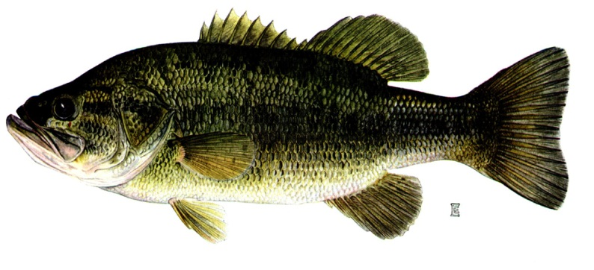
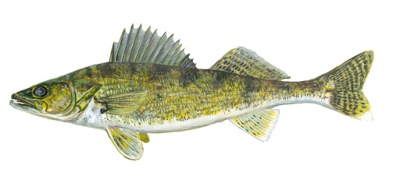

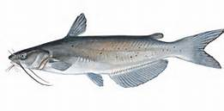
The Fishery of
North Brown’s Lake
Joe Stewig
Area Fisheries Manager
7/20/13
Notes:
Thank you for inviting me to speak today about the fishery of North Brown’s Lake and address any concerns that you may have regarding the recent lake survey.

Slide 2
Outline
Montrose Area Resources
Lake Survey Description
Lake Survey Results
Future Plans
Notes:
Before I get into the actual data. I want to give you a quick outline of what I will be talking about today. First, I will give you a little overview of the resources that the Montrose Area manages. Then I will go over what actually goes into a lake survey, then move on and describe what we found in our survey the last week of June. And finally discuss future plans moving forward.

Slide 3
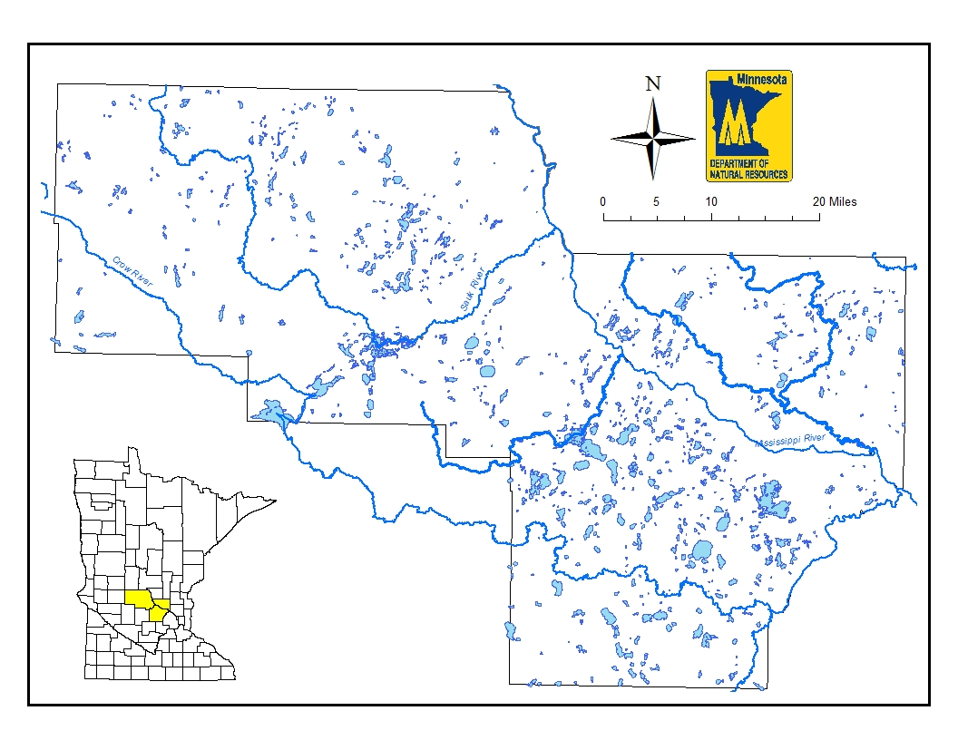
Montrose Area Resources
Notes:
The Montrose Area Fisheries Office is in charge of managing the lakes, rivers, and streams in Wright, Stearns, and Sherburne counties located in the Central part of the state. We manage about 150+ lakes, parts of 6 major river systems, and 7 viable trout streams in this area.

Slide 4
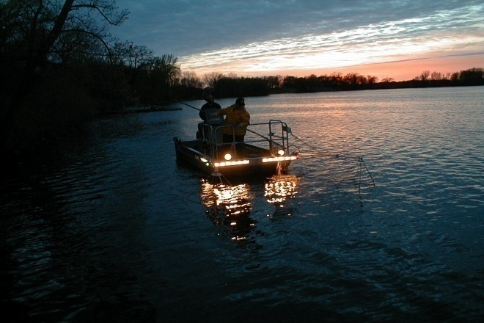
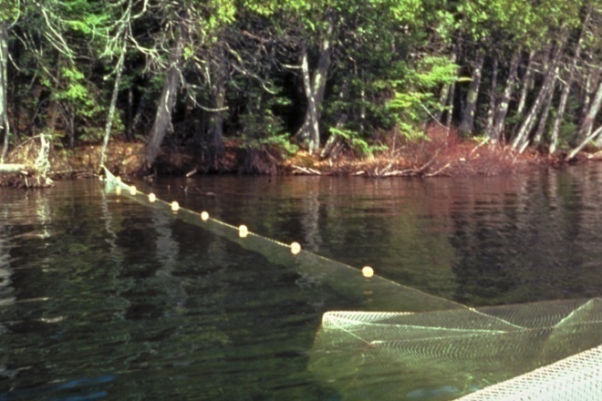
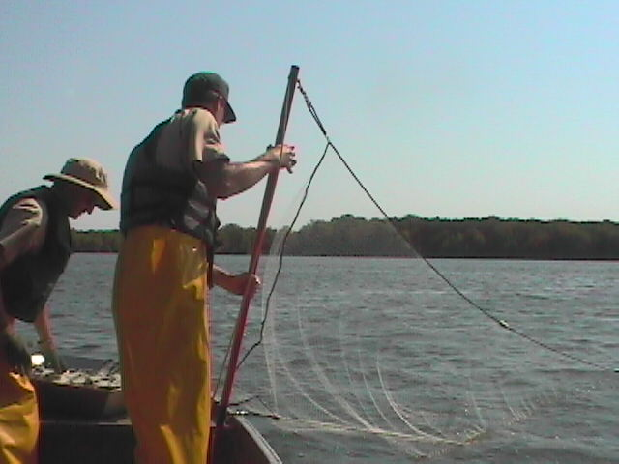
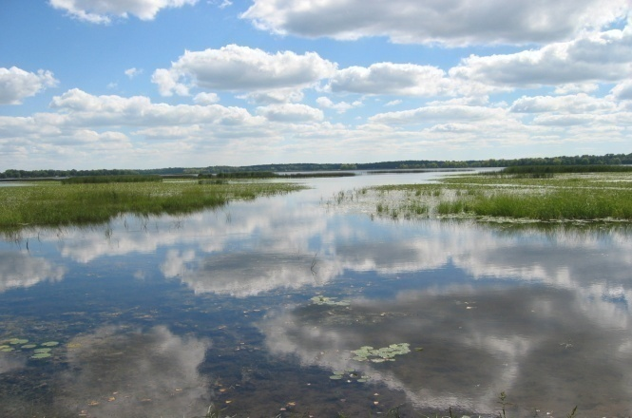
Standard Lake Survey
LMB Electrofishing
Curled Pondweed Mapping
Gill Net / Trap Net
Survey
Aquatic Vegetation Mapping
Notes:
Our office conducts between 15 and 20 lake surveys annually. Standard lake surveys consist of electrofishing largemouth bass once water temperature reach 55 degrees to assess the bass population. This usually occurs around the first part of May.
Next we map curly leaf pondweed abundance. We conduct this survey at the time of peak abundance usually the first part of June.
Then we move on to our summer gill net and trap net surveys. These are conducted weekly from mid-June through August.
The final step is the aquatic vegetation mapping which consists of mapping emergent and sub-mergent aquatic vegetation plants this usually starts the end of July and goes through August.

Slide 5
Outline
Montrose Area Resources
Lake Survey Description
Lake Survey Results
Moving forward
Notes:
Alright, that gives you a better idea what goes into a standard lake survey so lets look at the information from North Brown’s lake so far.

Slide 6
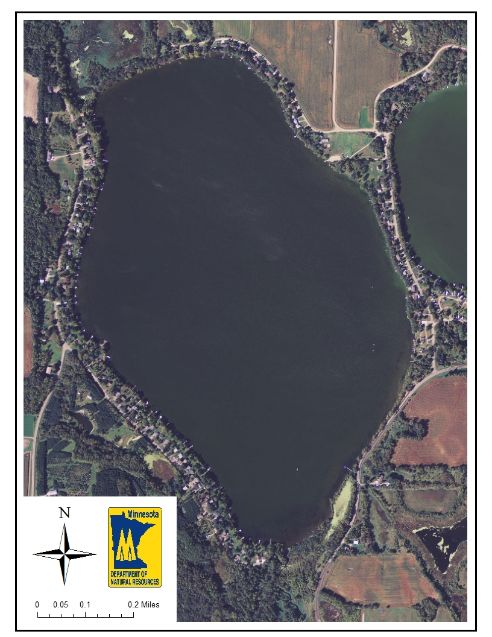
North Brown’s Lake
324 acres
130 littoral acres
Avg. depth – 18’
Max. depth – 41’
Walleye stocked in odd numbered years
Notes:
Well, this is a map of North Brown’s Lake as you know it is 324 acres of which 40% is considered littoral (< 15 ft). It has an average depth of 18’ and a maximum depth of 41’ . Walleye fry have been the stocking strategy since 2003 and are stocked during odd numbered years at a rate of 1,000 fry.

Slide 7

Largemouth
Bass
Notes:
Largemouth bass were sampled on May 23 and sampled at a rate of 33/ hr which is similar to the Montrose Area average of 38/hr. Bass sampled ranged from 7 – 19.3 inches and averaged just under 15 inches and 2.3 lbs. Proportional stock density, which is the number of bass longer than 8” that were also longer than 12”, was 81 and the RSD₁₅ was 58. Typically we like to see PSD values between 40 – 70 and RSD₁₅ values between 20 – 40. So, North Brown’s looks to be in pretty good shape.

Slide 8
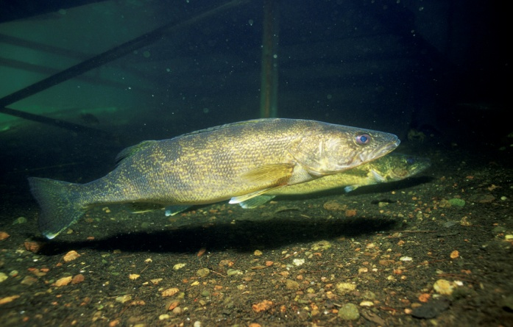
Walleye
Notes:
Since 2003, the walleye population has been sustained through fry stocking during odd numbered years. Now if we look at the walleye catch over time we see that the walleye catch has consistently been low and has ranged from 0.3 – 1.6/net. The dashed line represent the upper and lower range of expected values for lakes similar to North Brown’s. And so we see that only 2 surveys since 1980 have we had walleye catches within the range of expected values.

Slide 9
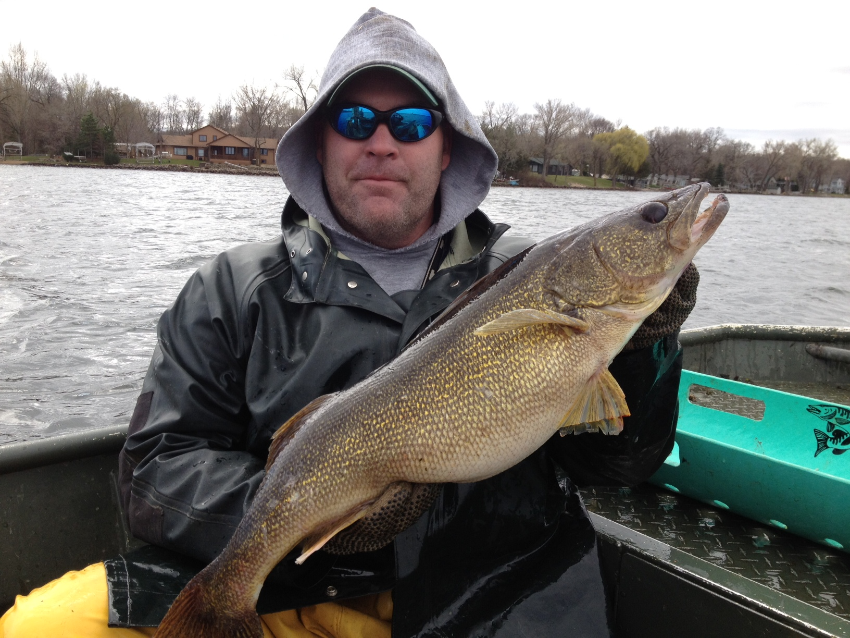
Fall YOY Walleye
Survival
Notes:
As I mentioned, since 2003 we have stocked North Brown’s Lake with walleye fry in order to try and produce better year classes and then follow up with fingerlings if fry survival is poor. This graph depicts our success or failure of recent stockings. The dashed lines represent a way to indicate a strong, average, or weak year class. So anything above the top dashed line would be considered a strong year class and anything below the lower dashed line would be considered a weak year class and those falling within the lines is considered an average year class. As you can see we have had relatively poor success with our fry stocking with the exception of 2005 when we had a strong year class produced. We again stocked the lake with 130,000 fry this spring and will shock again this fall to monitor the fry survival. Based on our walleye catches and YOY survival it might warrant looking at our stocking strategy.

Slide 10
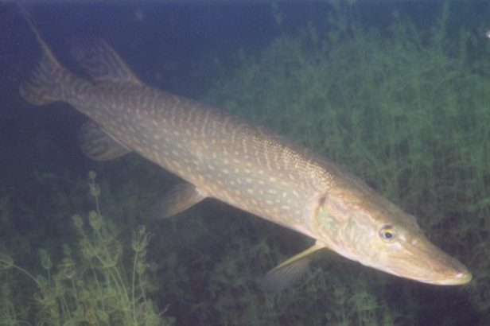
Northern Pike
Notes:
Moving on to Northern pike, we see that they have been abundant in the lake since 1985 and catch has ranged from 5.3 – 19.2/net. This year was no exception and similar to the past 2 surveys. Oddly enough the average size was above average.

Slide 11
Northern Pike
Notes:
This is the length frequency from the survey. NOP ranged in length from 18 – 34.5” and averaged 23.5 and 3 pounds which is above average for similar lakes.

Slide 12
Northern Pike
Notes:
Looking at the size structure we see that the NOP PSD has been above the goal of 50 since 1985 and the RSD₂₈ was about average.

Slide 13
Channel Catfish
Notes:
Now, looking at the channel catfish population. This was the first year that we sampled any real numbers of them and they were plentiful. Catfish were originally stocked into the SRCL back in 1987 by the Spicer office and gradually they have become abundant within the SRCL and are now abundant in North Brown’s Lake. Catfish were collected at a rate of 28.2/net up from 0.2 in 2003.

Slide 14
Channel Catfish
Notes:
Looking at the length frequency, channel catfish sampled ranged from 15 – 27 inches and averaged 19.2” and 2.4 lbs.

Slide 15
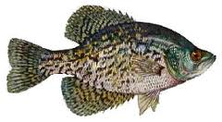
Black Crappie
Notes:
The crappie catch in 2013 was 3.5/net which was the lowest since 1980, but within the range of expected values for lakes similar to North Brown’s Lake.

Slide 16
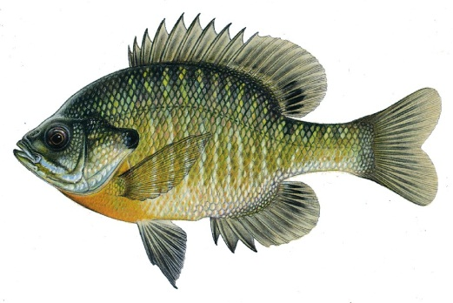
Bluegill
Notes:
The Bluegill population also was within the range of expected values and similar to past surveys with the exception of the 1990 survey.

Slide 17
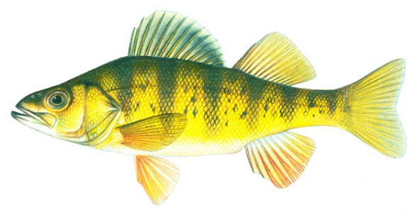
Yellow Perch
Notes:
Yellow perch numbers were the lowest recorded, but again were within the range of expected values and similar to the 2003 survey.

Slide 18
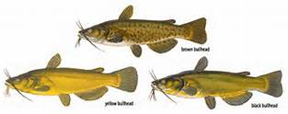
Bullhead species
Notes:
The catch of bullhead species shown a decrease since 1985 and was the second lowest ever recorded.

Slide 19
Summary
WAE catch low, similar across surveys
NOP catch high; average size good
CCF have arrived!!! Bullhead catch decreased
BLC, BLG, and YEP catch normal
Notes:
So to summarize, the walleye catch was low, but similar across surveys. The northern pike numbers were high, but oddly enough the average size was good averaging 23.5 inches and 3 pounds. Channel catfish have arrived and are here to stay. This was the first survey in which we caught any numbers of them. And we have seen a decrease in the bullhead catch. We have seen this on other SRCL lakes such as Horseshoe and Cedar Island. And finally BLC, BLG and YEP were all within the range of expected values.

Slide 20
What’s next???
Change in stocking strategy???
Liberalized catfish limit???
Summarize plant data and final write-up
Notes:
So, What’s next??? It appears that fry stocking isn’t as successful as we would like, but if we look back at our walleye catch during fingerling stocked years we also see that it didn’t equate to higher gill net catches. So, since walleye fry are relatively cheap I would suggest to continue with fry stocking possibly increasing the number stocked and then supplement the fry stocking with fingerling stocking during years with poor fry success. I also know that catfish are a source of concern among other SRCL lakes and I’m looking into the possibility of liberalizing the catfish limit to try and decrease the catfish population. We still have to summarize the plant data and the final report won’t be finalized until the Spring of next year.

Slide 21
Questions
More Information:
Montrose Area Fisheries Office:
Ph: 763-675-3301
Montrose Area Web site:
www.dnr.state.mn.us/areas/fisheries/montrose
DNR Web site: www.dnr.state.mn.us
Email: joe.stewig@state.mn.us
Notes:
With that here is where you can find additional information and with that I will take any questions.

Slide 22
Notes:
The other primary management species is walleye. This is the length frequency from our 2012 ice-out netting. We sampled 361 fish that ranged from 12” to 30” and averaged 21”.
The walleye population is modest in size, but has been stable and is maintained through stocking. A population estimate in 2012 estimated there to be 3.5 adults/acre up from 1.4 in 2007.

Slide 23
Northern Pike
Notes:
So, what else could be contributing to the decline in walleye. Lets look at the NOP population, in a lot of lakes we see an inverse relationship between WAE and NOP numbers. So as NOP catches increase we see a decrease in walleye catch. Looking at the NOP catch we have seen a significant increase in the catch since 1993 with our highest catch in 2009.

Slide 24


VS
Notes:
So, based solely on the largemouth bass data I’m not convinced that they are smoking gun? I would expect that LMB numbers to go up as water clarity improves and LMB habitat increases. On the other hand, the walleye catch might be negatively affected by the increase in water clarity because this might lead to net avoidance which could explain the slight decrease in the walleye catch over the past 3 surveys.

Slide 25
Summary
YEP catch decreasing; poor size structure
BLG abundant and slow growing; poor size structure
Improved water quality

Slide 26
Size Structure
Notes:
When we look at the size structure as described by PSD and RSD-15 we see that as

Slide 27
Size Structure

Slide 28
Size Structure

Slide 29
Northern Pike
Notes:
Northern pike is another one of the managed species that we are interested in and is another primary managed species in the lake. The northern pike population has a history of being abundant with a small average size. This is a typical length frequency of northern pike from our ice-out surveys. You can see that there is an abundant number of small northern pike and very few medium to large individuals.

Slide 30
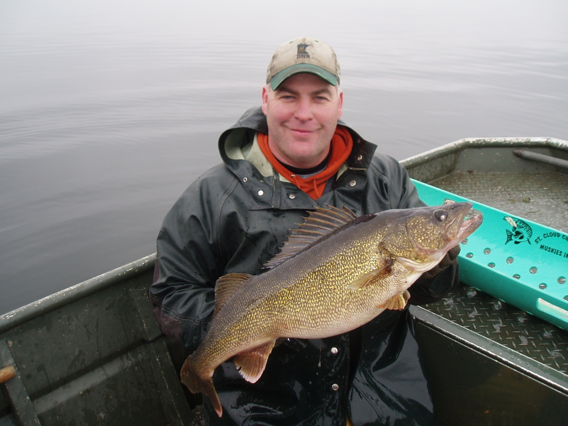
Walleye
Year | RSD20 | RSD24 | RSD27 | Avg TL
1998 | 55 | 24 | 6 | 21.0”
2003 | 54 | 27 | 12 | 21.1”
2007 | 57 | 27 | 8 | 21.1”
2012 | 56 | 27 | 4 | 21.0”
Notes:
If we look at previous ice-out assessments we see that all the structural indices are very similar indicating a very stable population.

Slide 31
Summary
Notes:
So, to summarize the MUE population continues to grow on Sugar Lake. Structural indices show increased proportion of fish over 42”. Averaged size has increased for the fourth assessment in a row. We saw our first 50” fish in 2007 and 2012!!! The population is within our target range of 0.2 – 0.4 adults/acre. If we see our population go below 0.2, I would recommend increasing our stocking numbers and vice versa if we start to exceed 0.4 adults/acres I would consider reducing our stocking numbers. Thanks again to all the volunteers. I enjoy taking people out and showing them what we do. It is a good way to get to know some of our clientele.

Slide 32
Summary

